Slide 1
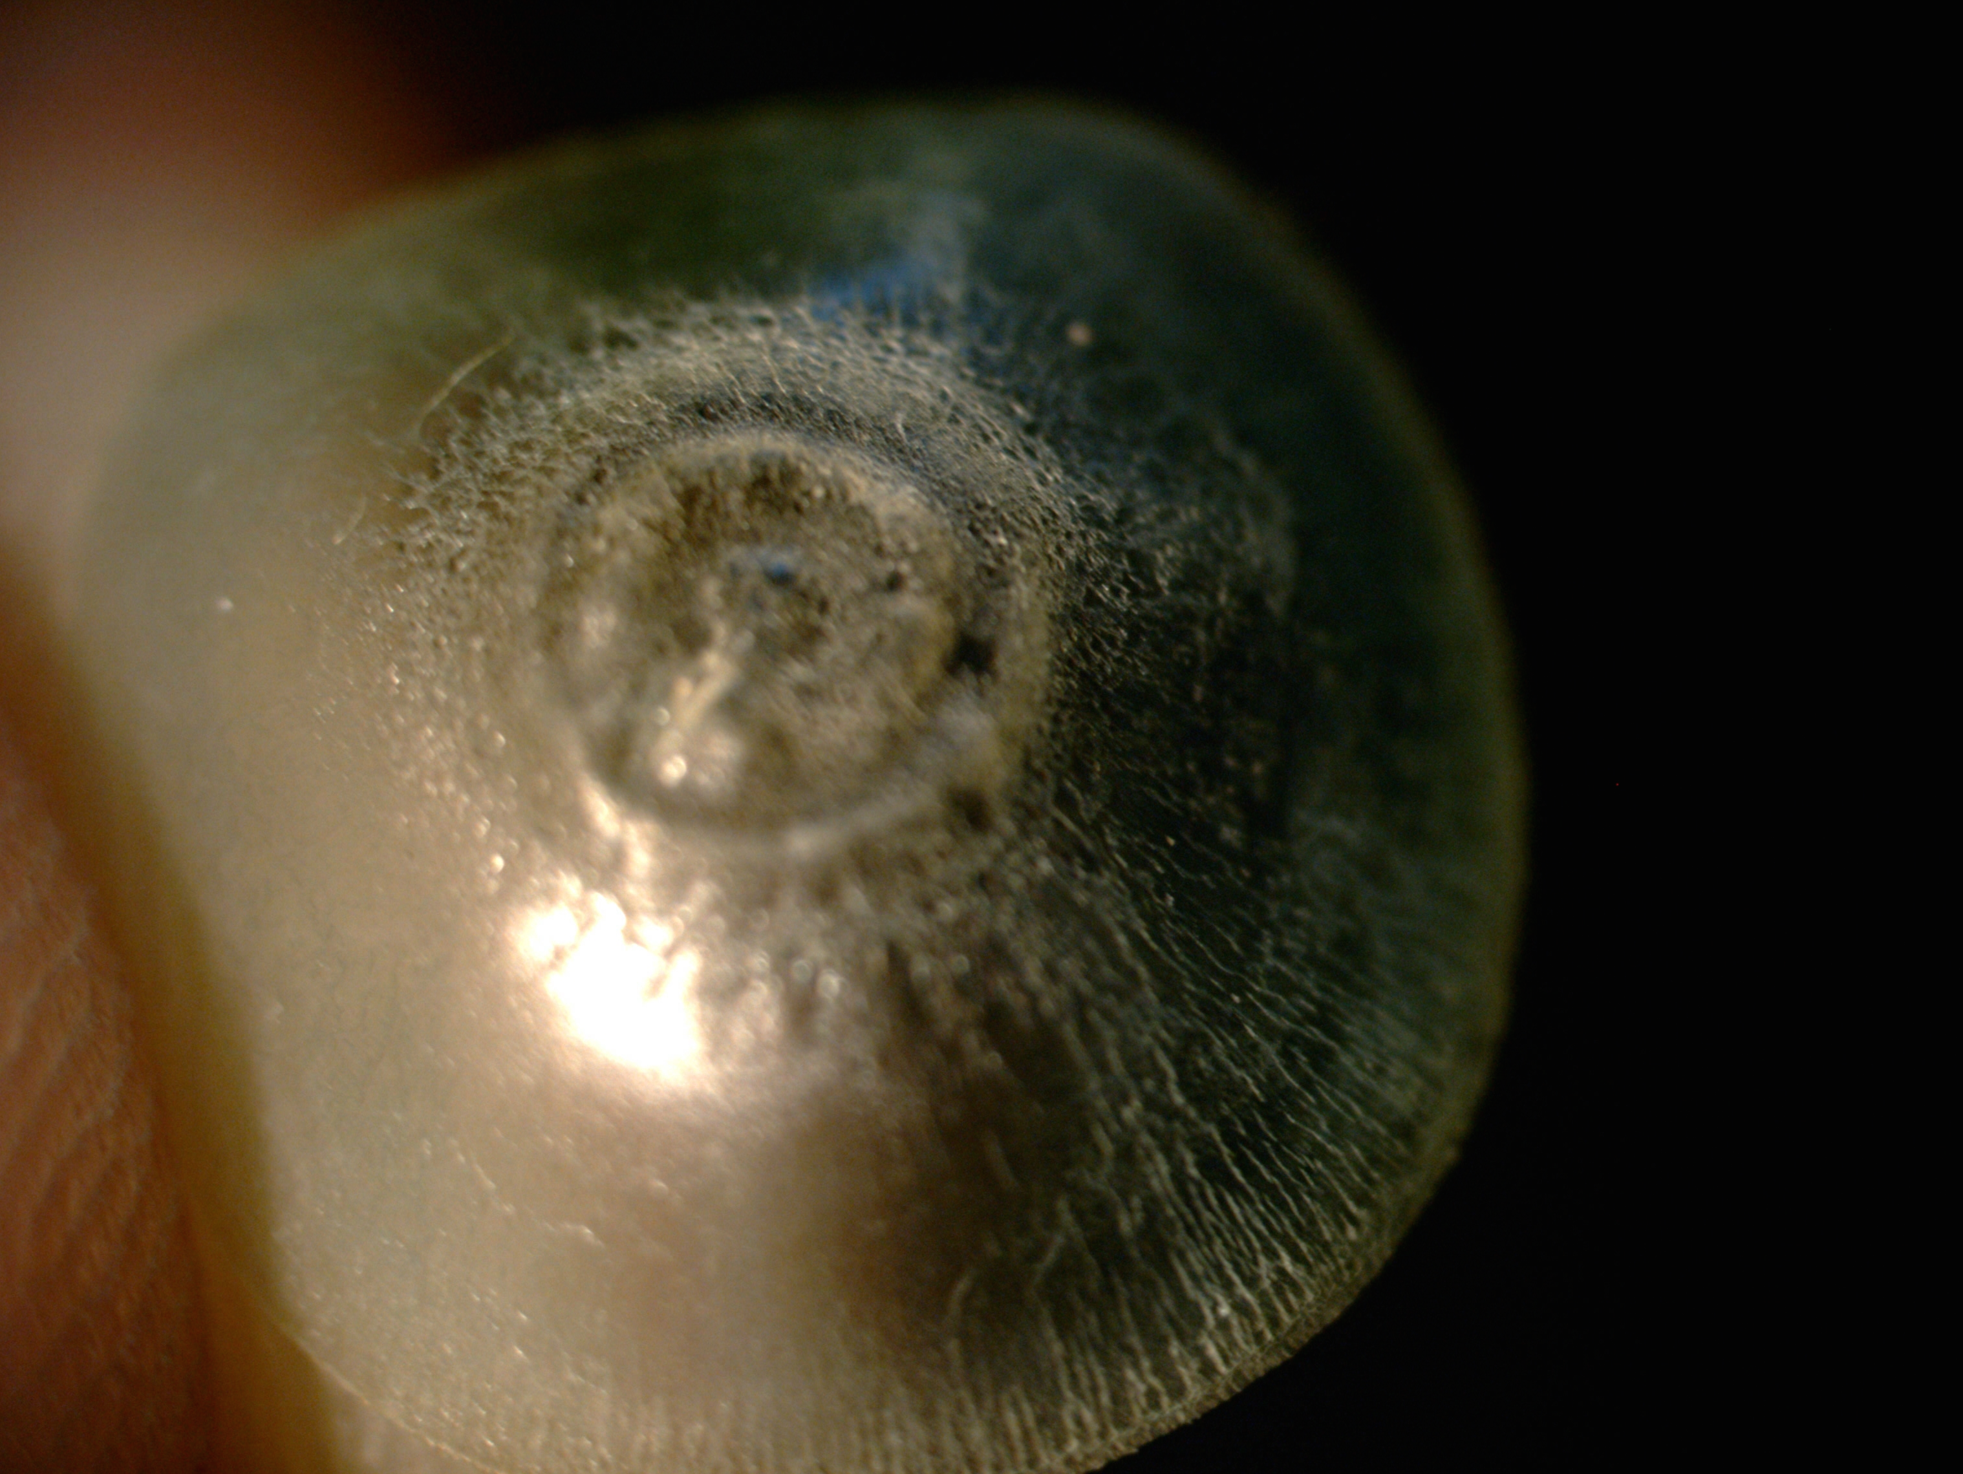
A Silicone Hydrogel Contact Lens After 7 Years Of Continuous Wear
Nilufer Yesilirmak^{1,2},MD, Dilek D. Altinors², MD
1-Bascom Palmer Eye Institute, University of Miami Miller School of Medicine, Florida/USA
2-Baskent University Hospital, Department of Ophthalmology Ankara/Turkey

Slide 2
Purpose
To report an unusual case with a continuous 7 years wear of bandage silicone hydrogel contact lens over cyanoacrylate glue application for corneal perforation.

Slide 3
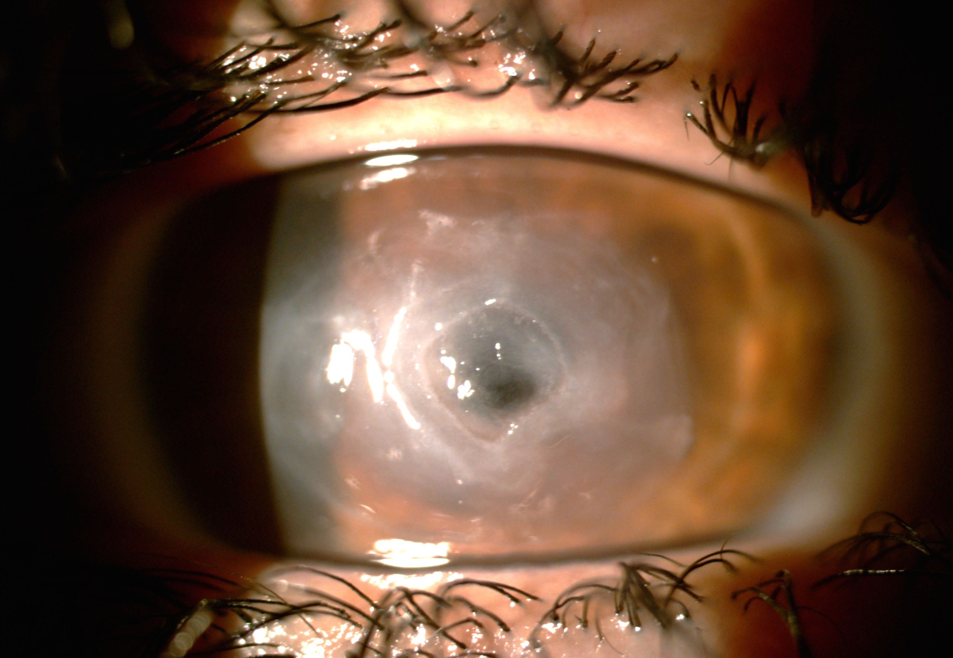
Case Report
A 67-year-old woman with acute symptoms of tearing, pain and visual loss in her left eye
History of ocular trauma in the left eye, 20 years ago.
Evaluation (left eye):
BCVA: light perception
Corneal edema and an average 3 mm central corneal perforation
Flat anterior chamber and positive Seidel test
Treatment:
Cyanoacrylate adhesive and a bandage silicone hydrogel contact lens were applied at the site of perforation
Topical moxifloxacin HCl % 0.5 drops 2qh, 3 mg/g ciprofloxacin HCl ophthalmic ointment and cycloplegia once a day
Follow-up:
At 1st-3rd day, 1st-6th week, 3rd-7th month
Visual acuity, anterior chamber depth, inflammatory reaction and glue adherence were recorded and contact lens was renewed.

Slide 4
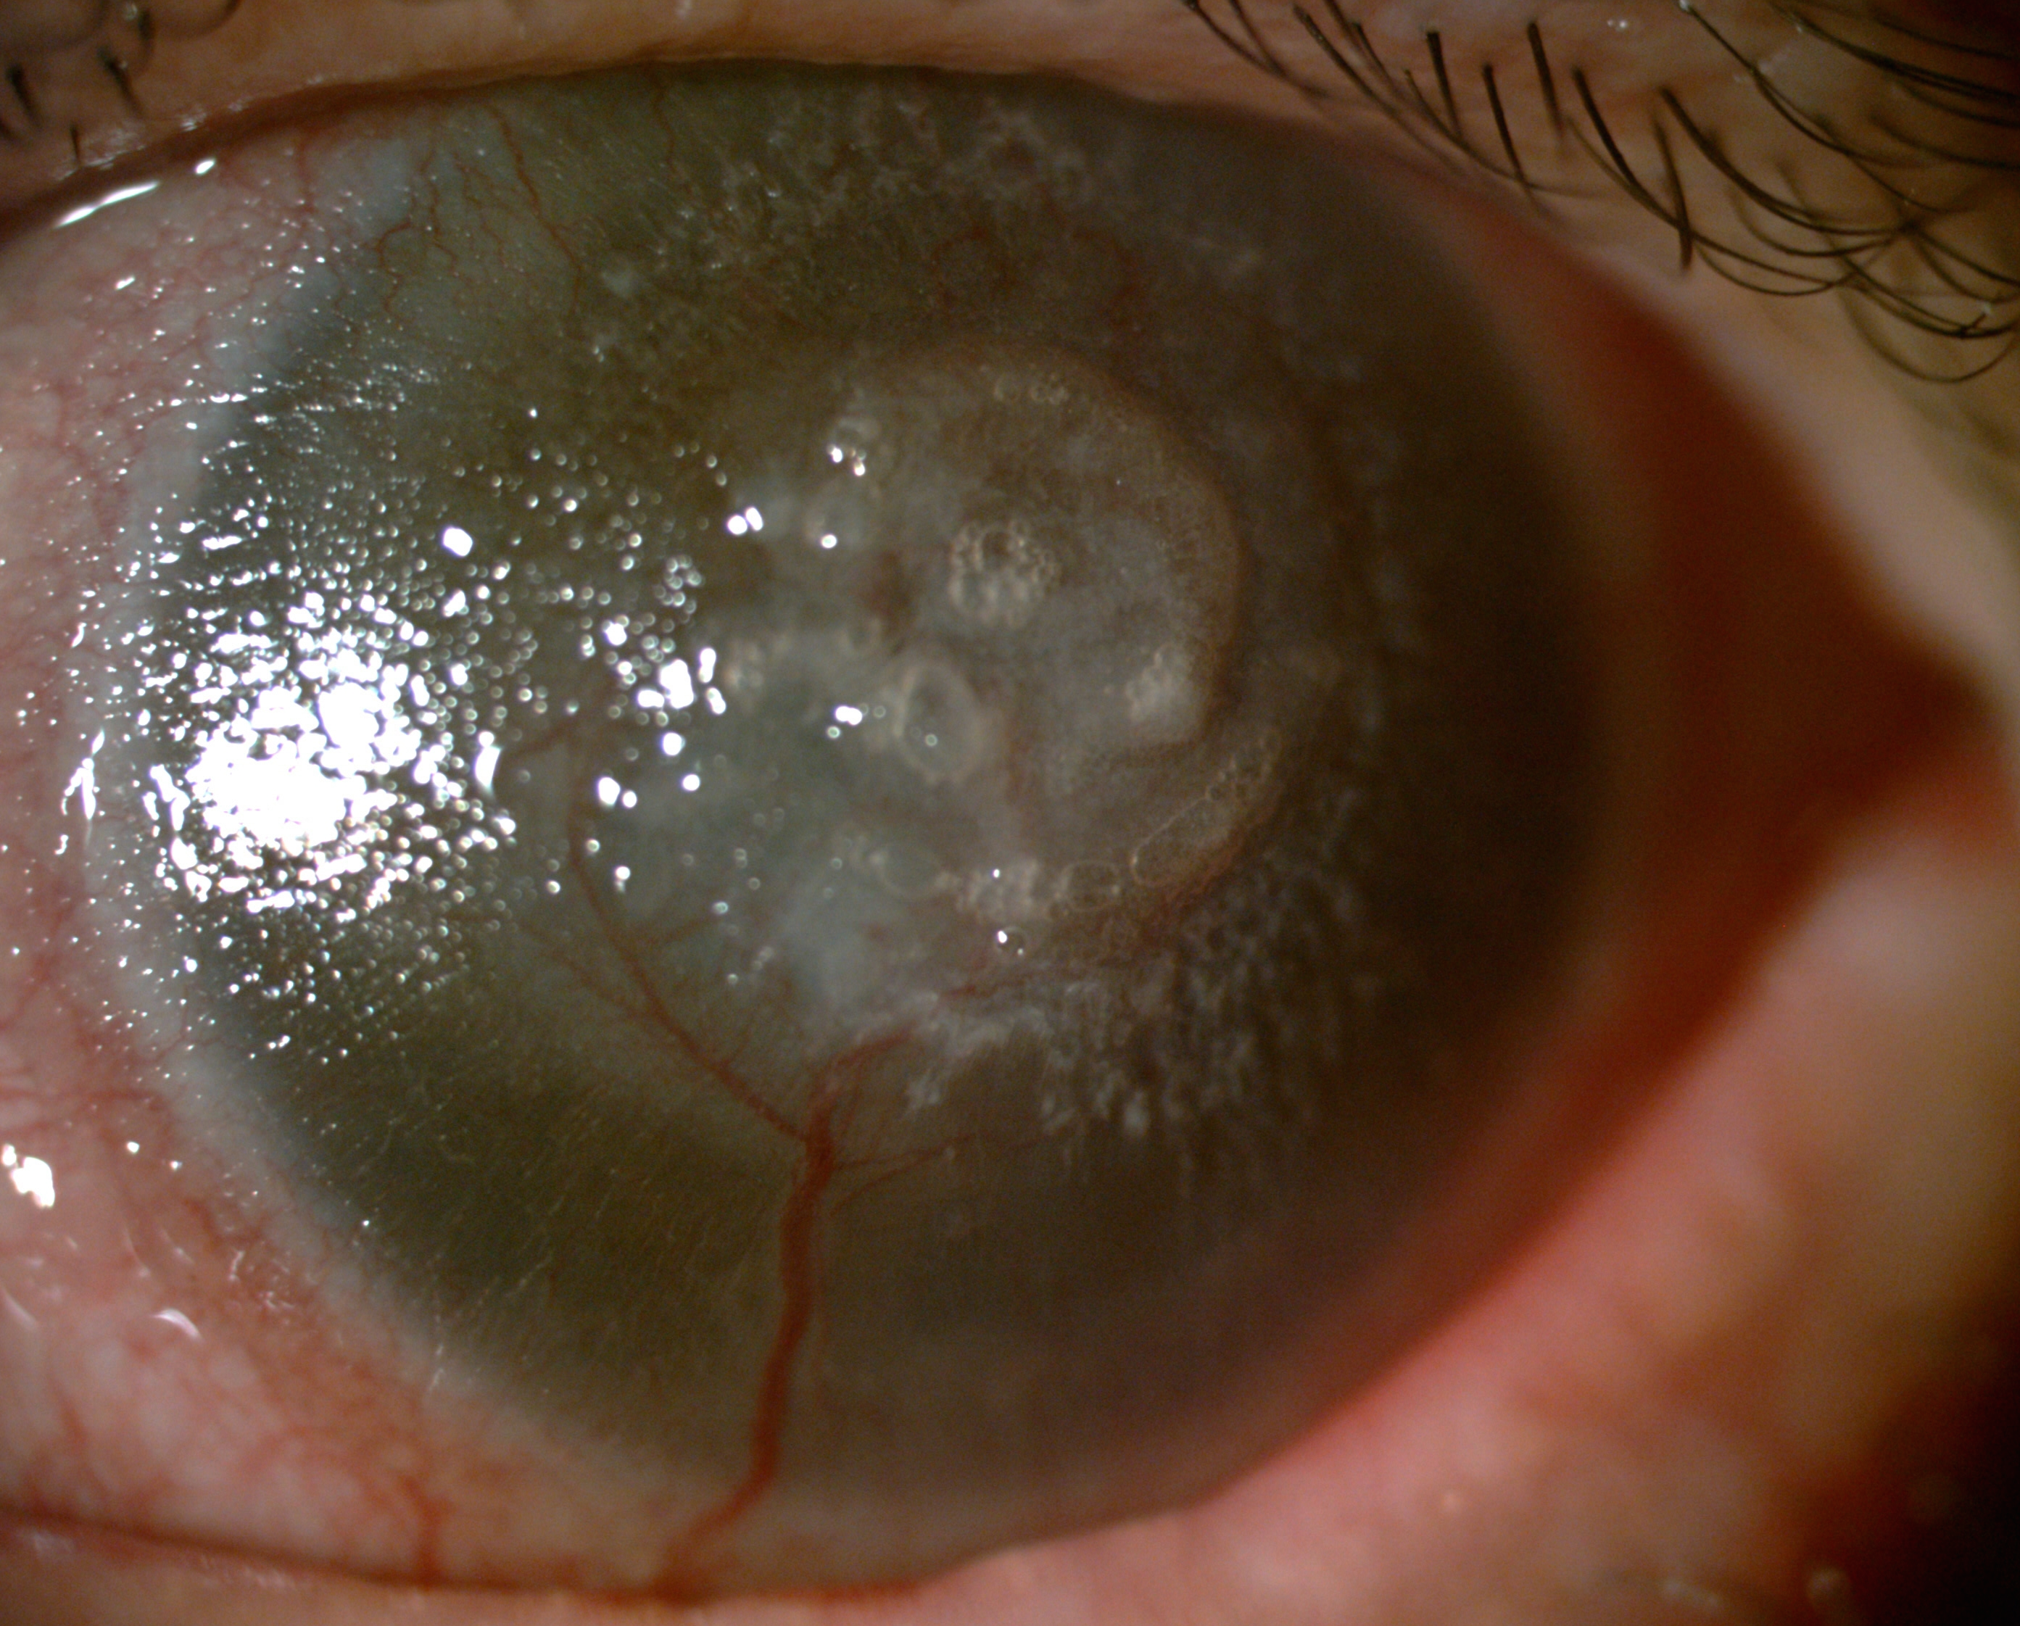
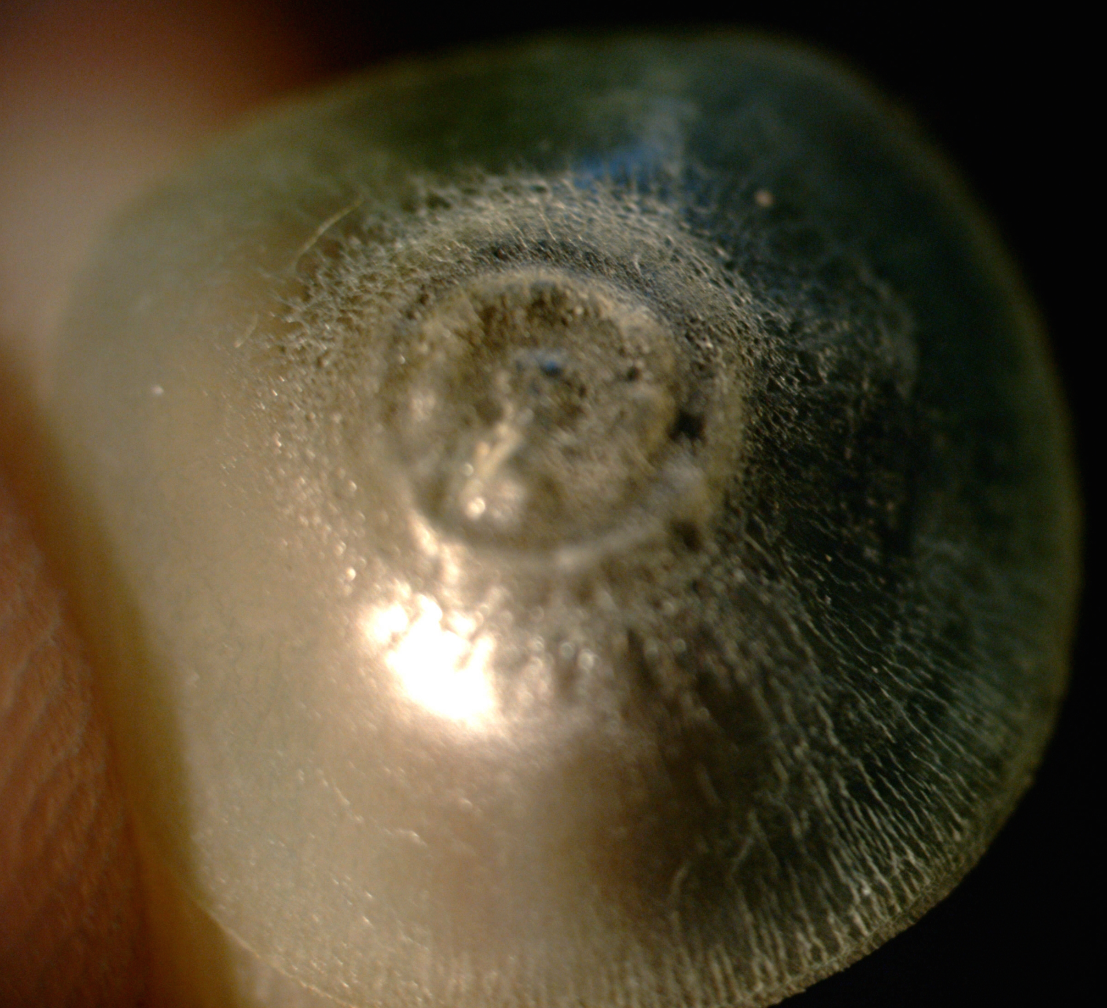
Results
Patient was lost to follow-up and somehow at the end of the 7th year, she applied with complaining of redness and gritty sensation in the left eye.
She mentioned that she continued to use topical antibiotic drops once a day during those 7 years.
Examination:
A formed anterior chamber, a diffuse corneal vascularization and a pannus formation (Figure A)
No infectious reaction
Despite the multiple streaks and deformations, the lens was compact (Figure B).
A
B

Slide 5
Conclusions
This study is the first report about the continuous wear of a contact lens for seven years without being taken off.
Silicone hydrogel contact lenses exhibit good long term tolerance (at least seven years) when utilized as a continuous wear therapeutic lens with topical antibiotics use.

